Slide 1

DATA ANALYSIS ON TAB’S PRICES

Slide 2
TEAM MEMBERS:
B.Raj Ganesh
B.COM ( Computer Application )
P.Satish
B.COM (Computer Application )
WORK EXPERIENCE:
Fresher

Slide 3
PROBLEM STATEMENT:
To gather data on the tabs . After collecting the data analysing the price and rating of the tabs.
OBJECTIVE:
Analysing and identifying the best prices and ratings of the tabs.
Tabs are frequently used for entertainment purpose , including streaming videos , playing games . reading e-books and browsing the internet

Slide 4





LIBRARIES USED:
Requests
Beautiful Soup
Regex(re)
Pandas
Matplotlib
Seaborn

Slide 5
WEB SCRAPPING:
Web scrapping is an automatic way to retrieve unstructures data from a website and store them in a structured format.
STEPS:
Taking the website that you want to work.
Access the URL of website using code and download all the HTML contents on the page.
Find out the request – response that gives you the data that you want.
Depending on the type of request get simulate the request in your code and retrieve the data from website.
Extract out useful info that you need.

Slide 6
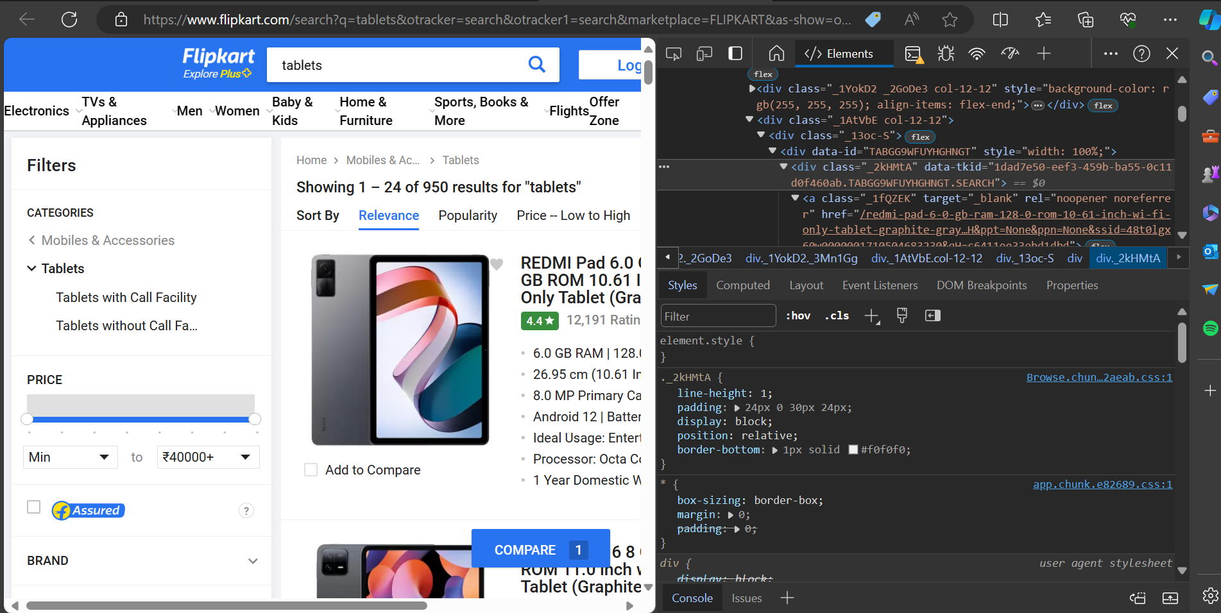
DATA COLLECTION
URL : https://www.flipkart.com/search?q=tablets&otracker=search&otracker1=search&marketplace=FLIPKART&as-show=on&as=off
Here, we have to used this website to get the data

Slide 7
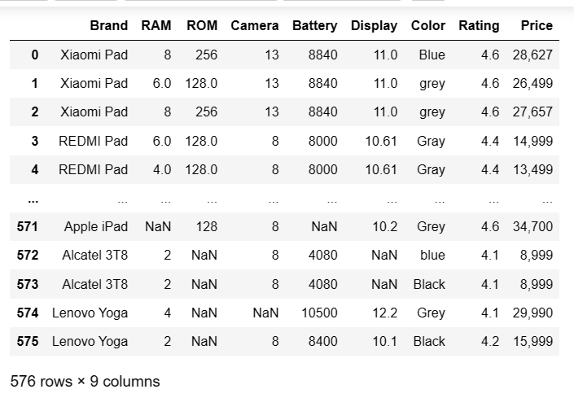
RAW DATA:
This is the collected Raw data

Slide 8
DATA CLEANING STEPS:
Removing special characters and converting types.
Finding Missing values and Filling them with techniques.
Finding Duplicate values and Drop the duplicates from the data.
Identify the Outliers and Noisy data.
Type casting to change the datatype.

Slide 9
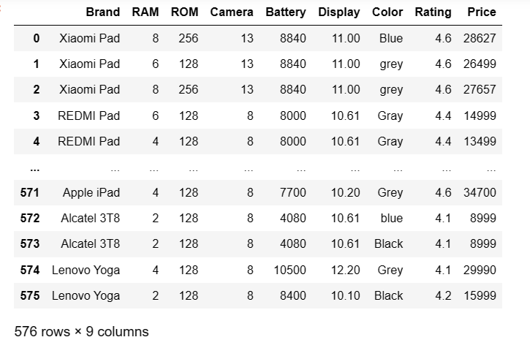
FINAL DATA AFTER CLEANING:
The final data structure having 576 rows and 9 columns.

Slide 10

DATA VISUALIZATION:
Data visualization is a graphical representation for analyzing the data.To finding inshights and patterns.
TYPES OF INSIGHTS:
Data distribution
Outliers
Relationship
Break down the data
Trend
Compare the data
TYPES OF PLOTS:
Uni variate Analysis
Bi variate Analysis
Multi variate Analysis

Slide 11
Uni variate Analysis:
Univariate data consists only single variable.
Categoical data
Numerical data
Bi variate Analysis:
Bivariate data consists two variables, to finding the relationship between two variables.
Categorical vs Categorical
Continous vs Continous
Categorical vs Continous
Multi variate Analysis:
Finding the correlation coefficient relationship between more than two variables.

Slide 12
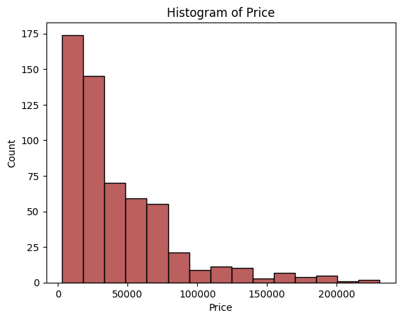
ANALYSIS ON PRICE:
Insights
The Histogram plot distributes the value count of prices.
Most of the tab’s prices are below 50,000
The less number of tab’s prices from 1,50,000 to 2,00,000

Slide 13
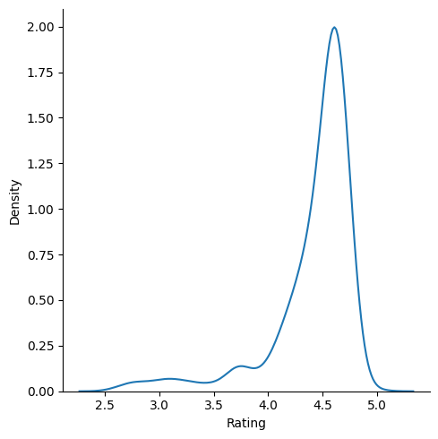
ANALYSIS ON RATING:
Insights
The density plot shows the probability on Rating.
In this plot most of the tab’s Rating from 4.0 to 5.0

Slide 14
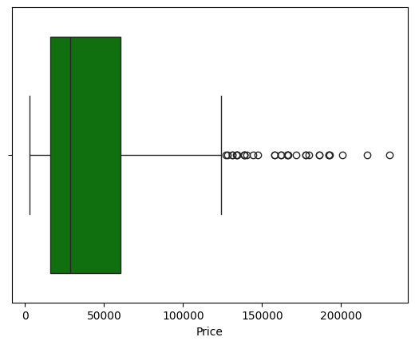
Insights
The Box plot shows the Outlier of the price on tab’s.
Above 1 Lakh are the Outliers of the price.

Slide 15
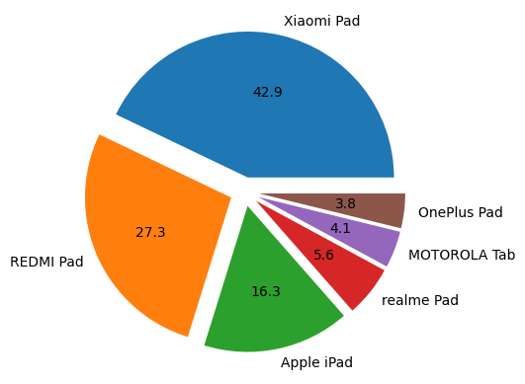
ANALYSIS ON BRAND NAMES:
Insights
The pie chart shows the percentage of the tab’s brand.
Xiaomi pad brand are the highest percentage i.e 42.9%
One plus brand are the lowest percentage i.e 3.8%

Slide 16
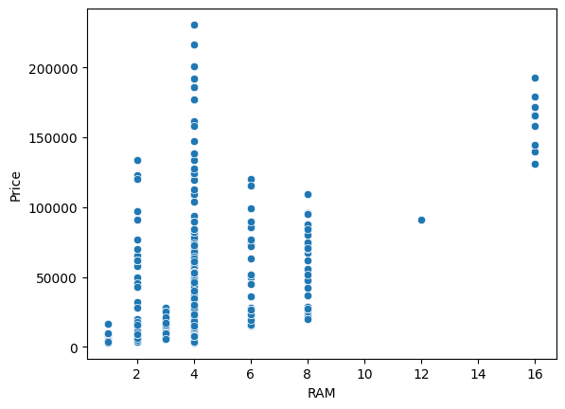
ANALYSIS ON RAM AND PRICE:
Insights
RAM ranges from 2 to 16,in this plot we have 16 GB RAM and its prices between around 1.4 Lakh-1.8 Lakh
In this plot we have only one 12 GB RAM tab and its price is
1 Lakh.
There is no tabs on 10 GB and 14 GB RAM

Slide 17
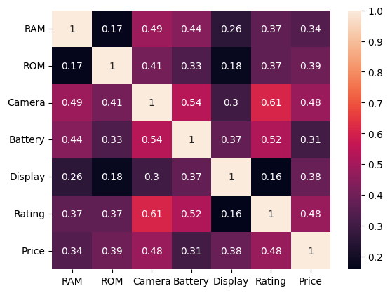
Insights
The heat map shows the correlation coefficient relationship between more than two values.
The relationship between price and RAM is positively very weak,the correlation coefficient is 0.34.
The relationship between ROM and rating is positively very weak,the correlation coefficient is 0.37.
The relationship between camera and rating is positively moderate,the correlation coefficient is 0.61.

Slide 18
Conclusions :
As per our analysis, We conclude that Xiaomi Tab is the
popular choice for customers with a reasonable price and also Xiaomi Tab has good ratings

Slide 19

THANK YOU

